Slide 1
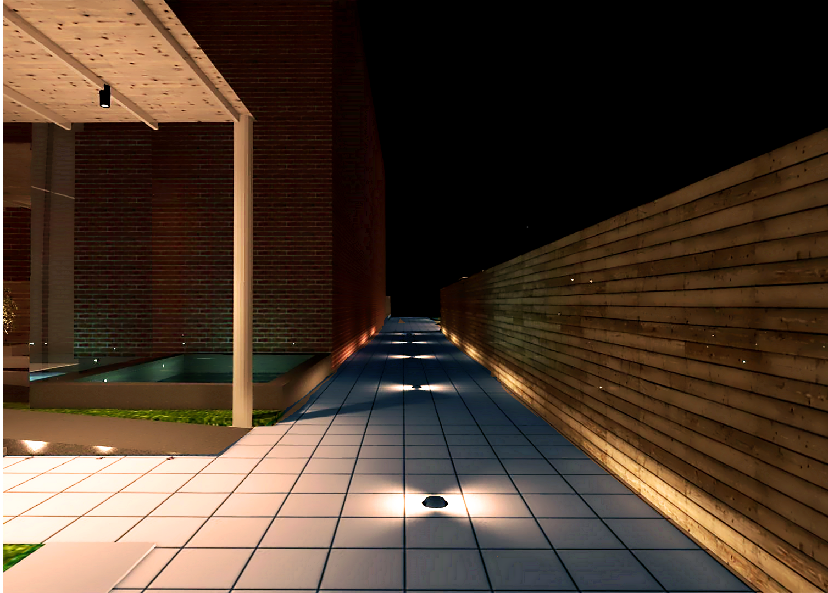
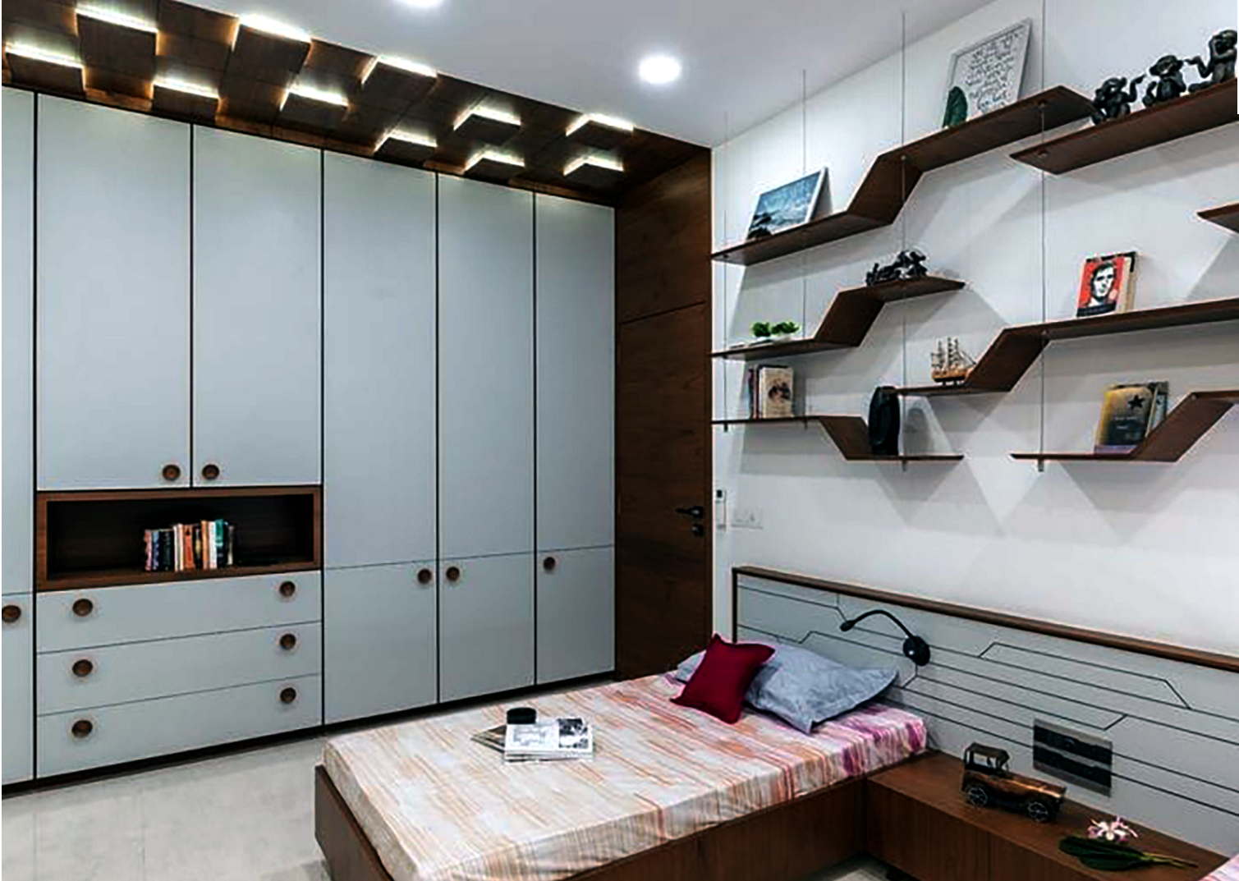
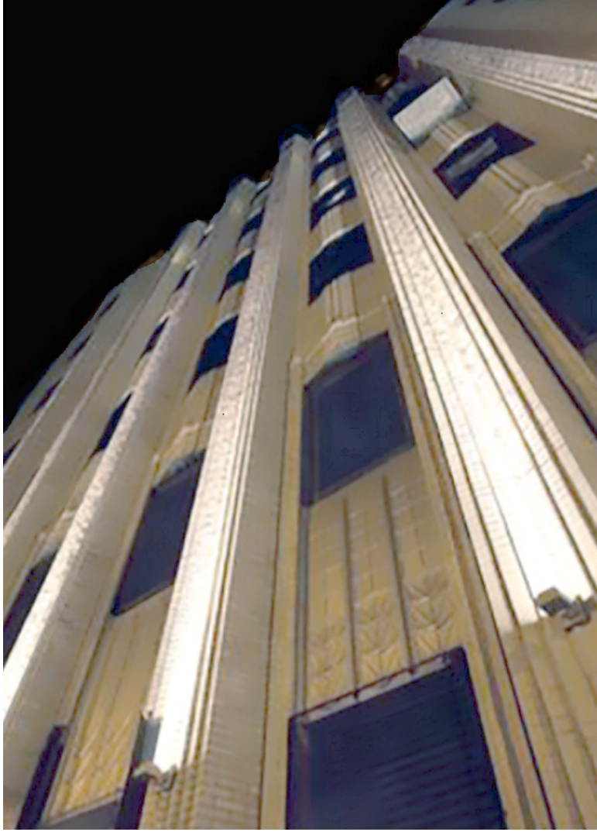
Landscape Lighting
Lighting Master Plan for Townships
Lighting Master Plan for SEZs
Swimming Pools & Waterbodies
Fountain Lighting (Son et Lumiere)
Street Lighting/Tunnel Lighting
Outdoor Sports Facilities
Airport Aprons/Runway
Taxiway Lighting
Seaports/Shipping Yards
Golf Courses
Green Building Landscape Lighting
Smart City Lighting Masterplans
Hospitality Lighting
Malls & Multiplexes
Corporate offices
Hospitals & ICU Lighting
Fitness Centres
Residential Interiors
Museums & Art Galleries
Client Experience Centres
Airport Terminal Buildings
Indoor Stadiums
Human-Centric Lighting
Aircraft Interior Lighting
Luxury Yatch Lighting
Interior
Lighting
Façade
Architectural
Lighting
Exterior
Lighting
Heritage Buildings & Monuments
Commercial Towers
Malls
Mixed Use Facilities
Hotels
Cruise Ships
Parliament Houses
Secratariat Buildings
IT Buildings
Schools
Stadiums
Residential Towers
Green Building Facade Lighting
Airport Terminal Buildings
City Beautification

